Slide 1
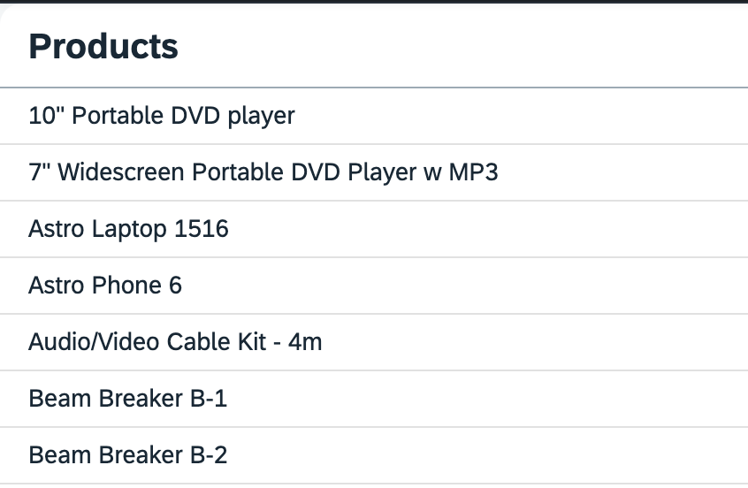

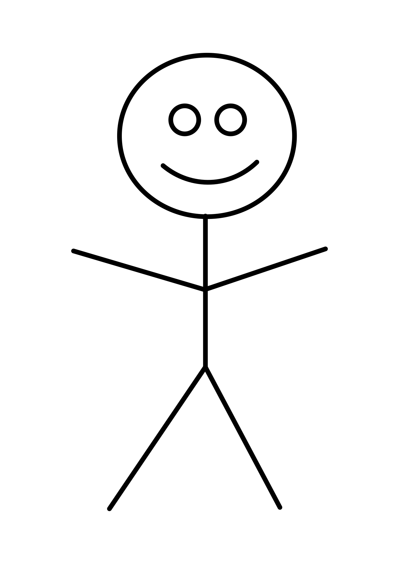
MVC (Model View Controller) Design Pattern divides an application into 3 parts
Model
Holds application data
manipulates
"Products": [
{
"ProductId": "HT-2001",
"Category": "Accessories",
"Name": "10\" Portable DVD player”
},
{
"ProductId": "HT-2000",
"Category": "Accessories",
"Name": "7\" Widescreen Portable DVD Player w MP3"
},
{
"ProductId": "HT-1251",
"Category": ”Computer Systems",
"Name": ”Astro Laptop 1516"
}
]
"Products": [
{
"ProductId": "HT-2001",
"Category": "Accessories",
"Name": "10\" Portable DVD player”
},
{
"ProductId": "HT-2000",
"Category": "Accessories",
"Name": "7\" Widescreen Portable DVD Player w MP3"
}
updates
View
Controller
Presents the data to the user
Manipulates the model
sap.ui.define([
'sap/ui/core/mvc/Controller’,
'sap/ui/model/json/JSONModel'
], function(Controller, JSONModel) {
"use strict";
var ListController = Controller.extend("sample..List", {
function: addProduct() {
…
}
return ListController;
});
sap.ui.define([
'sap/ui/core/mvc/Controller’,
'sap/ui/model/json/JSONModel'
], function(Controller, JSONModel) {
"use strict";
var ListController = Controller.extend("sample..List", {
function: addProduct() {
…
}
return ListController;
});
interacts
invokes

